Slide 1




GROUP
4
What makes a song highly streamable?
SEARCH

Slide 2


GROUP 4
Welcome
Our Team
Welcome
Variables
Methodology
Music streaming platforms, led by Spotify, have revolutionized the way music reaches listeners, allowing for instant global distribution. This presentation shows the factors that are driving song popularity on streaming platforms using the Spotify Most Streamed Songs Dataset, sourced from Kaggle.
Visualisation
Experiment
Conclusion
Thank You
Play
Follow
Notes:
Zara

Slide 3




GROUP 4
Welcome
Our Team
Variables
Our Team
Methodology
Visualisation
Experiment
Conclusion
Thank You
Aarushi Kotwani
Mark Daza
Zahra Ahmadi Angali
Surya Kailash Ramesh
Data Scientist
Data Scientist
Data Scientist
Data Scientist
Notes:
all

Slide 4
GROUP 4
Variables
Welcome
Our Team
Categorical Columns
Numerical Columns
Variables
Methodology
Track_name
Artist(s)_name
Key
Mode
Cover_url
Artist_count
Released_year
Released_month
Released_day
In_spotify_play
Listsin_spotify_charts
Streams
In_apple_playlists
In_apple_charts
In_deezer_playlist
In_deezer_charts
In_shazam_charts
Bpm (Beats Per Minute)
danceability_%
valence_%
energy_%
acousticness_%
instrumentalnes_%
liveness_%
speechiness_%
Visualisation
Experiment
Conclusion
Thank You
4

Slide 5
GROUP 4
Methodology
Welcome
Our Team
Raw Dataset
Clean Data
Perform EDA
Exploratory Insights
Generate Visualizations
Data Import
Analyze Relationships
Generate Insights
Correlation Insights
Data Wrangling
Insights Visualization
Driving Conclusions
Variables
Methodology
Visualisation
Experiment
Conclusion
Thank You
5

Slide 6
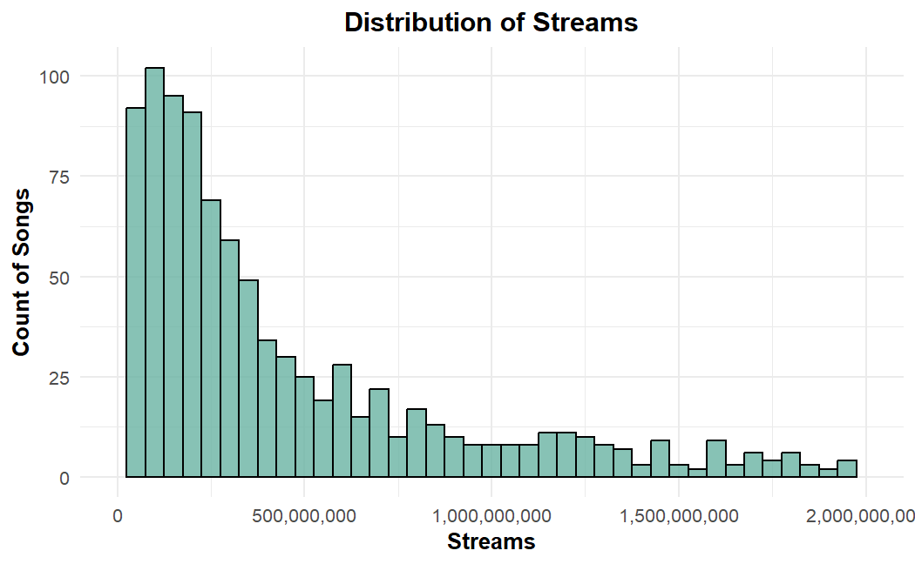
GROUP 4
Visualisation
Skewed Distribution
Gradual Decline
Rare High-Stream Songs
Long Tail
0:23
-3:25
6
Notes:
This box plot illustrates the distribution of song streaming counts on Spotify based on the number of contributing artists (ranging from single artists to collaborations with up to eight artists). The y-axis represents the number of streams on a logarithmic scale, capturing a wide range of values, while the x-axis indicates the count of contributing artists.
Key Observations:
Streaming Count Median and Spread:
The median count of streams in a song from a single artist is quite high, while the IQR remains considerably narrow. This implies the performance across the single artists has remained consistent.
In cases of multiple contributing artists, this median streaming count sees small fluctuations and often stays comparable, at least up to five artists in one song.
Outliers:
Throughout the artist counts, the highly outlying points for the really high streams stand out and indicate blockbuster hits.
The songs with single or dual artists have more outliers that are really high streaming.
Collaboration Dynamics:
Songs with more artists (e.g., six or more) show increased variability, as can be seen in the wider range of the box plot and whiskers.
The data for seven and eight artists is sparse, with small sample sizes and narrower ranges of streaming counts, which makes generalization difficult.
Insights:
Consistency in Singles and Smaller Collaborations: Songs with one or two artists tend to perform consistently well, probably because of strong individual branding or synergy between fewer collaborators.
Potential Impact of Big Collaborations: Songs by many artists are more inconsistent across streaming counts, perhaps an indication that large collaborations serve niche audiences or have very specific marketing needs for viability.
Log Scales Have Their Advantages: A log scale in terms of streams serves well in highlighting trends and outliers while ensuring that lower and high streaming counts are proportionately represented.
The preceding chart emphasizes the multifaceted nature of collaborations, given the success of both pure solo tracks and multi-artistic collaborations, even as these two types of musical collaboration show different levels of regularity and dispersion.

Slide 7
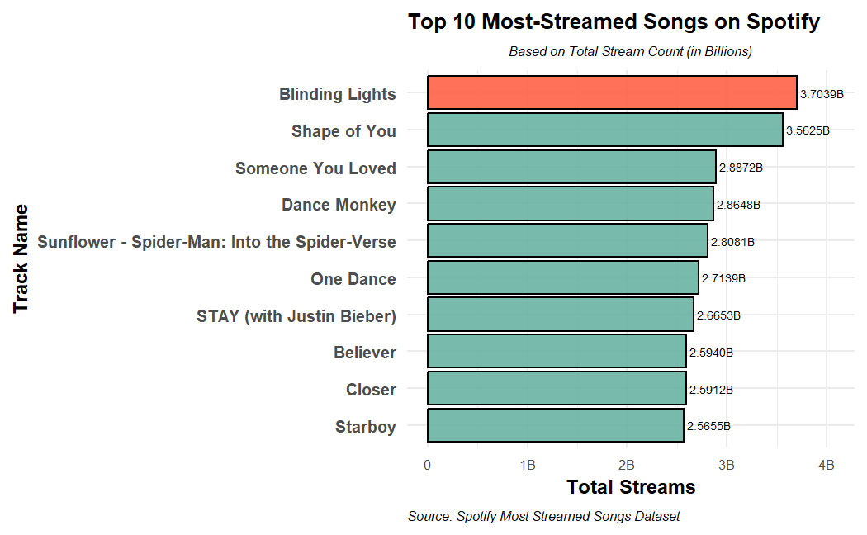
GROUP 4
Visualisation
Top Song: Blinding Lights
Highly Streamed Songs
Narrow Range
0:23
-3:25
7
Notes:
This box plot illustrates the distribution of song streaming counts on Spotify based on the number of contributing artists (ranging from single artists to collaborations with up to eight artists). The y-axis represents the number of streams on a logarithmic scale, capturing a wide range of values, while the x-axis indicates the count of contributing artists.
Key Observations:
Streaming Count Median and Spread:
The median count of streams in a song from a single artist is quite high, while the IQR remains considerably narrow. This implies the performance across the single artists has remained consistent.
In cases of multiple contributing artists, this median streaming count sees small fluctuations and often stays comparable, at least up to five artists in one song.
Outliers:
Throughout the artist counts, the highly outlying points for the really high streams stand out and indicate blockbuster hits.
The songs with single or dual artists have more outliers that are really high streaming.
Collaboration Dynamics:
Songs with more artists (e.g., six or more) show increased variability, as can be seen in the wider range of the box plot and whiskers.
The data for seven and eight artists is sparse, with small sample sizes and narrower ranges of streaming counts, which makes generalization difficult.
Insights:
Consistency in Singles and Smaller Collaborations: Songs with one or two artists tend to perform consistently well, probably because of strong individual branding or synergy between fewer collaborators.
Potential Impact of Big Collaborations: Songs by many artists are more inconsistent across streaming counts, perhaps an indication that large collaborations serve niche audiences or have very specific marketing needs for viability.
Log Scales Have Their Advantages: A log scale in terms of streams serves well in highlighting trends and outliers while ensuring that lower and high streaming counts are proportionately represented.
The preceding chart emphasizes the multifaceted nature of collaborations, given the success of both pure solo tracks and multi-artistic collaborations, even as these two types of musical collaboration show different levels of regularity and dispersion.

Slide 8
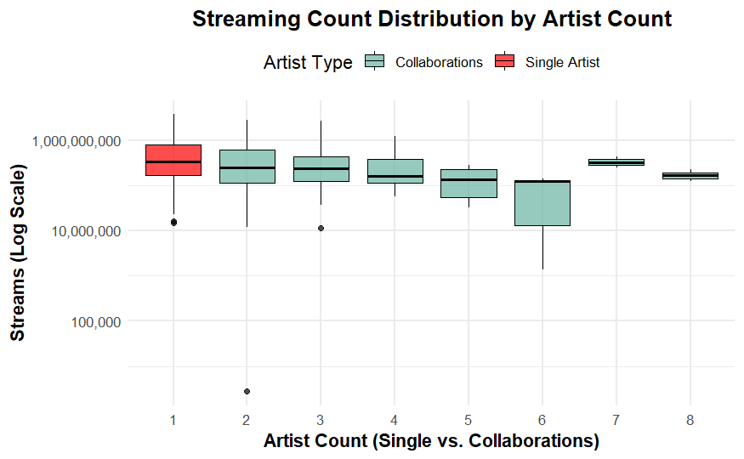
GROUP 4
Visualisation
Streaming Count Median and Spread
Outliers
Collaboration Dynamics
8
0:23
-3:25
Notes:
This box plot illustrates the distribution of song streaming counts on Spotify based on the number of contributing artists (ranging from single artists to collaborations with up to eight artists). The y-axis represents the number of streams on a logarithmic scale, capturing a wide range of values, while the x-axis indicates the count of contributing artists.
Key Observations:
Streaming Count Median and Spread:
The median count of streams in a song from a single artist is quite high, while the IQR remains considerably narrow. This implies the performance across the single artists has remained consistent.
In cases of multiple contributing artists, this median streaming count sees small fluctuations and often stays comparable, at least up to five artists in one song.
Outliers:
Throughout the artist counts, the highly outlying points for the really high streams stand out and indicate blockbuster hits.
The songs with single or dual artists have more outliers that are really high streaming.
Collaboration Dynamics:
Songs with more artists (e.g., six or more) show increased variability, as can be seen in the wider range of the box plot and whiskers.
The data for seven and eight artists is sparse, with small sample sizes and narrower ranges of streaming counts, which makes generalization difficult.
Insights:
Consistency in Singles and Smaller Collaborations: Songs with one or two artists tend to perform consistently well, probably because of strong individual branding or synergy between fewer collaborators.
Potential Impact of Big Collaborations: Songs by many artists are more inconsistent across streaming counts, perhaps an indication that large collaborations serve niche audiences or have very specific marketing needs for viability.
Log Scales Have Their Advantages: A log scale in terms of streams serves well in highlighting trends and outliers while ensuring that lower and high streaming counts are proportionately represented.
The preceding chart emphasizes the multifaceted nature of collaborations, given the success of both pure solo tracks and multi-artistic collaborations, even as these two types of musical collaboration show different levels of regularity and dispersion.

Slide 9
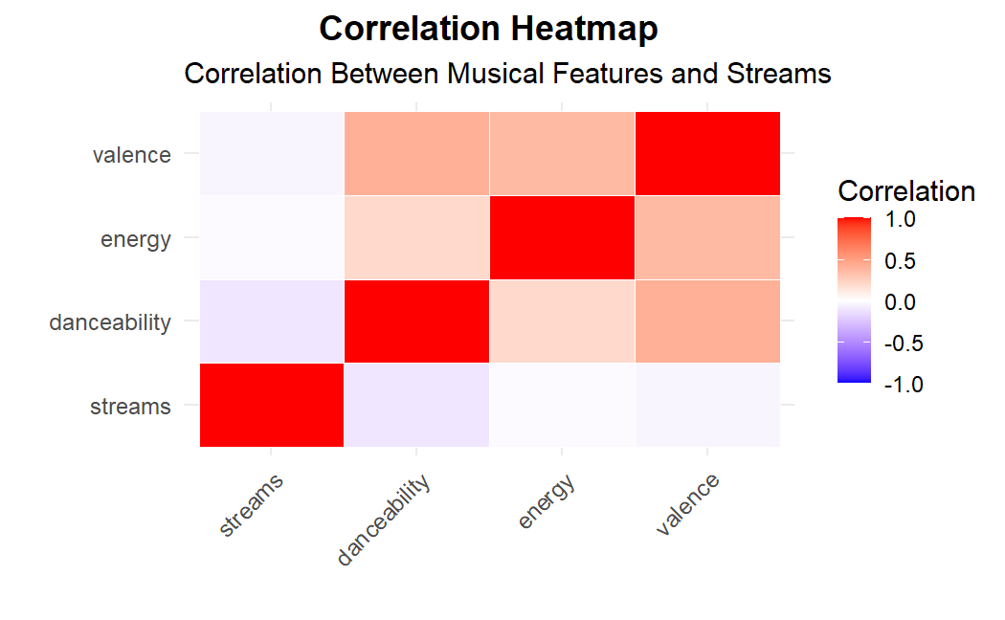
GROUP 4
Visualisation
Positive Correlation :
Valence, Danceability, Energy
Weak Link with Streams
Musical Qualities alone do not significantly drive its popularity.
0:23
-3:25
9

Slide 10
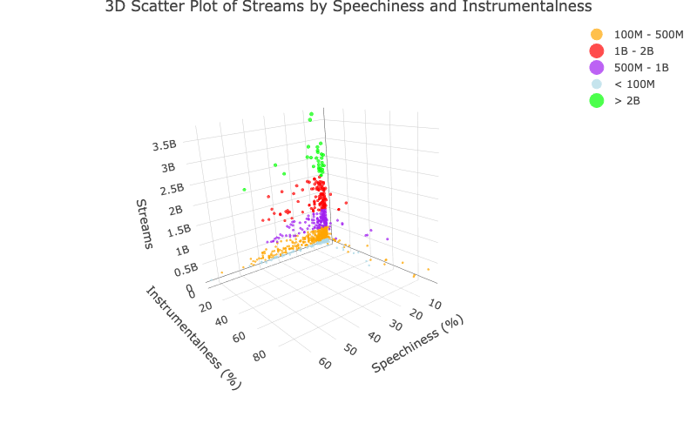
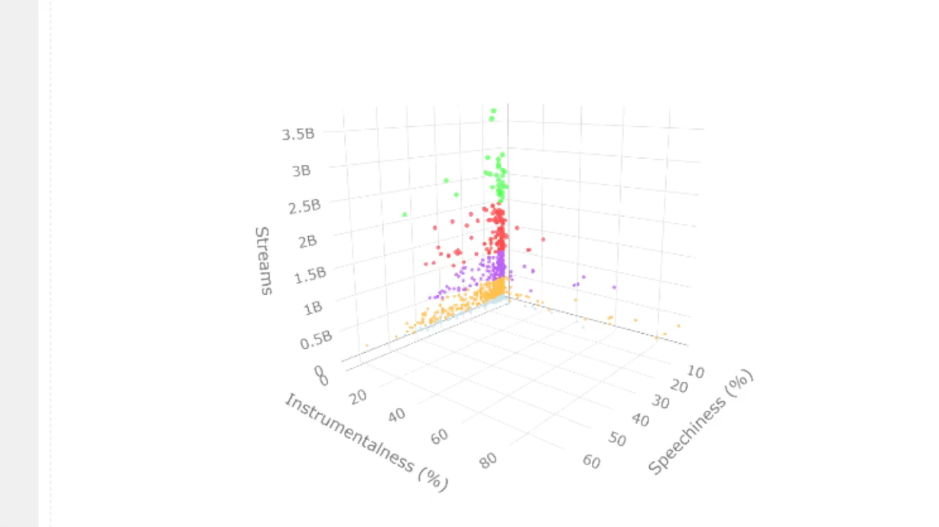
GROUP 4
Visualisation
High-Stream Songs Cluster at Low Speechiness and High Instrumentalness
Low-Stream Songs Are More Dispersed
Clustering Reflects Popularity Trends
Instrumental Content Drives Popularity
0:23
-3:25
10

Slide 11
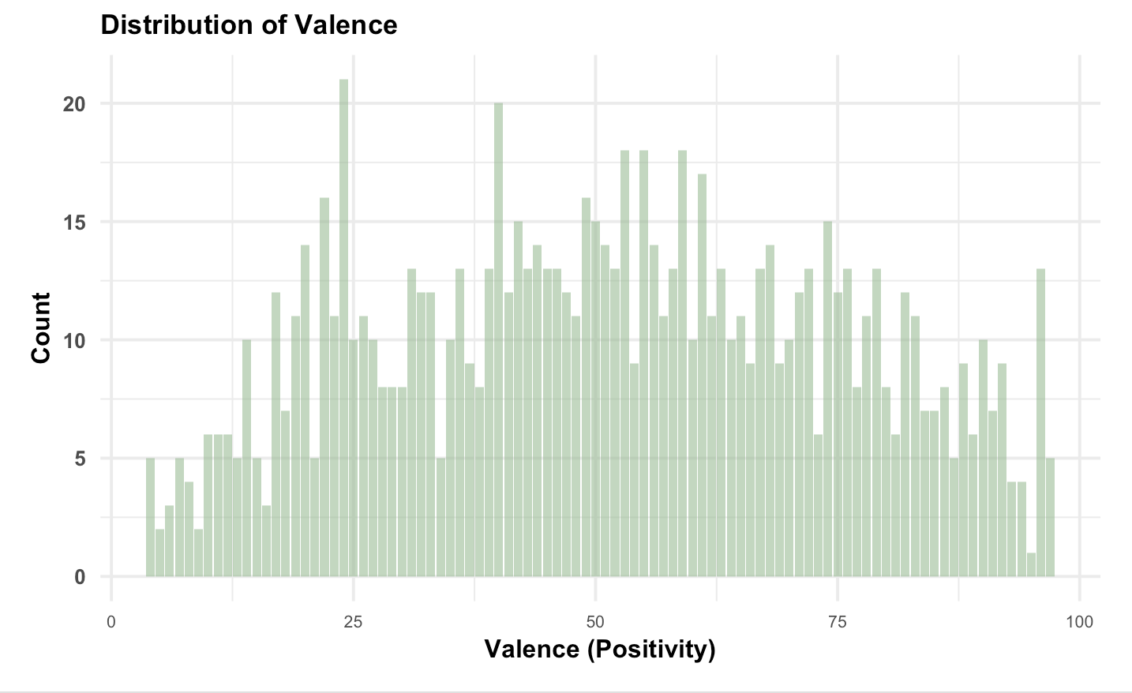
GROUP 4
Visualisation
Valence Scores Range from
The distribution reflects a wide diversity of emotional tone
Peaks near valence scores of 25 and 50 indicate balanced popularity
0:23
-3:25
11

Slide 12
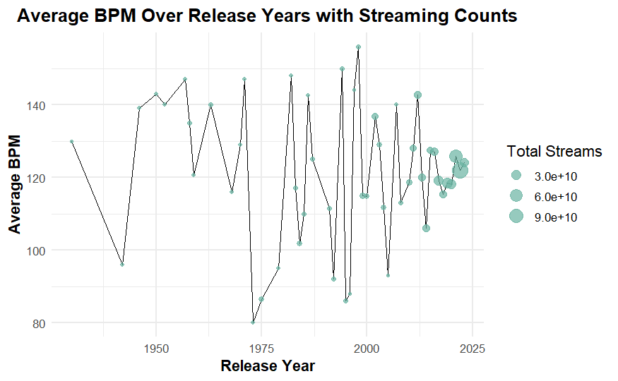
GROUP 4
Visualisation
Fluctuation in Average BPM
Concentration of Streams in Recent Years
Outliers in BPM
0:23
-3:25
12

Slide 13
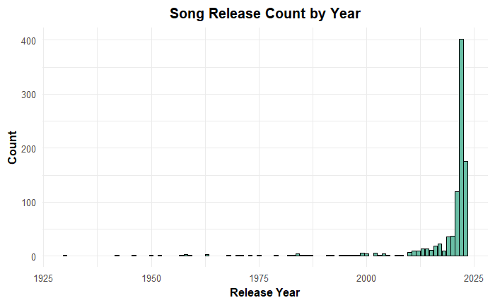
GROUP 4
Visualisation
Spotify's most-streamed songs are from recent years
Very few songs on the list were released before the year 2000.
There is dominance of contemporary music, with older songs.
0:23
-3:25
13

Slide 14
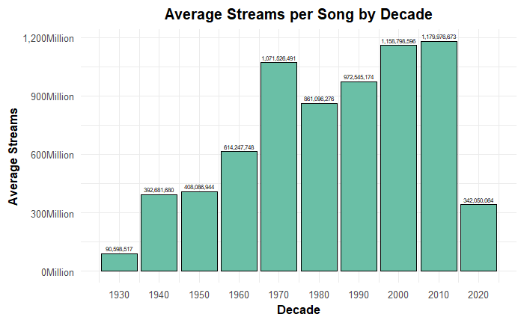
GROUP 4
Visualisation
The highest average streams are 2000’s- 2010’s
The rise in streams starting in the 1960s may reflect the enduring popularity of iconic tracks
Average streams for earlier decades are lower but still impressive
0:23
-3:25
14

Slide 15
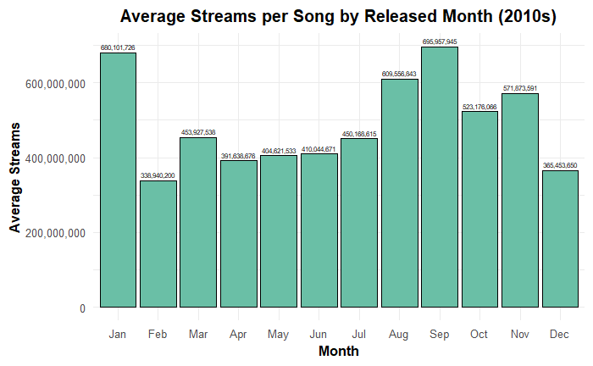
GROUP 4
Visualisation
Explore seasonal trends and streaming performance
Early in the year (January) or during the back-to-school period (September) tend to perform exceptionally well.
Lower averages in other months may reflect varying industry strategies
0:23
-3:25
15

Slide 16
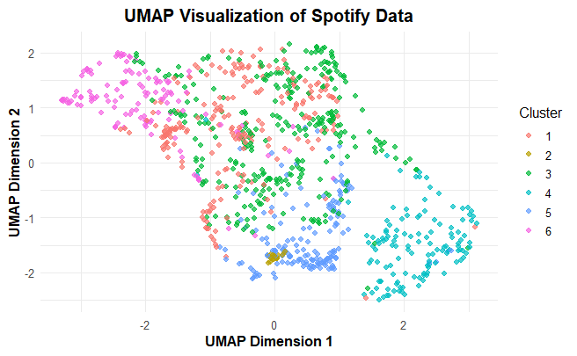
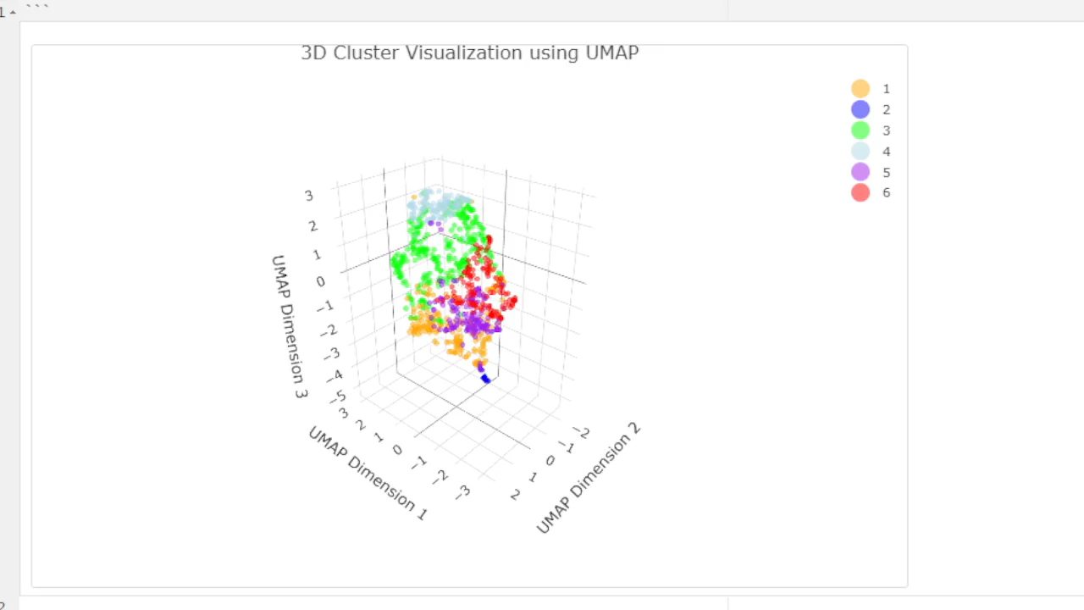
GROUP 4
Experiment
Uniform Manifold Approximation and Projection
bpm,
Danceability
valence_%
energy_%
acousticness_%
instrumentalness_%
liveness_%
speechiness_%
Distinct Clusters
Overlapping Amongst Clusters
Cluster Density
0:23
-3:25
16

Slide 17

Conclusion
Playlist Inclusion: Plays a critical role in driving streams.
Musical Attributes: Energy, danceability, and positivity do not significantly impact streams.
Strategic Approaches: Emphasize the need for strategies to maximize visibility and engagement in a competitive market.
0:23
-3:25

Slide 18
Thank You
0:23
-3:25

Slide 19
Any Questions?
0:23
-3:25

Slide 20
Reference
Unsplash. (n.d.). Photo. Retrieved from Unsplash
Flaticon. (n.d.). Profile icons. Retrieved from Flaticon
Kaggle. (n.d.). Spotify Most Streamed Songs Dataset. Retrieved from Kaggle
0:23
-3:25

